Slide 1
L-J Model of Argon

Slide 2
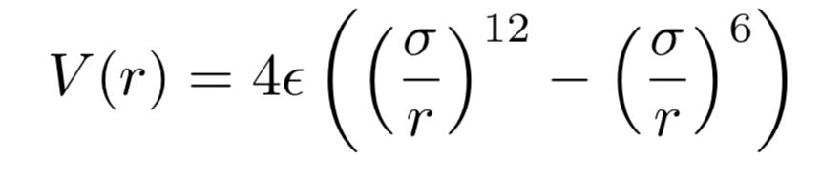
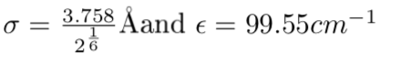
12-6 form of Lennard-Jones potential

Slide 3
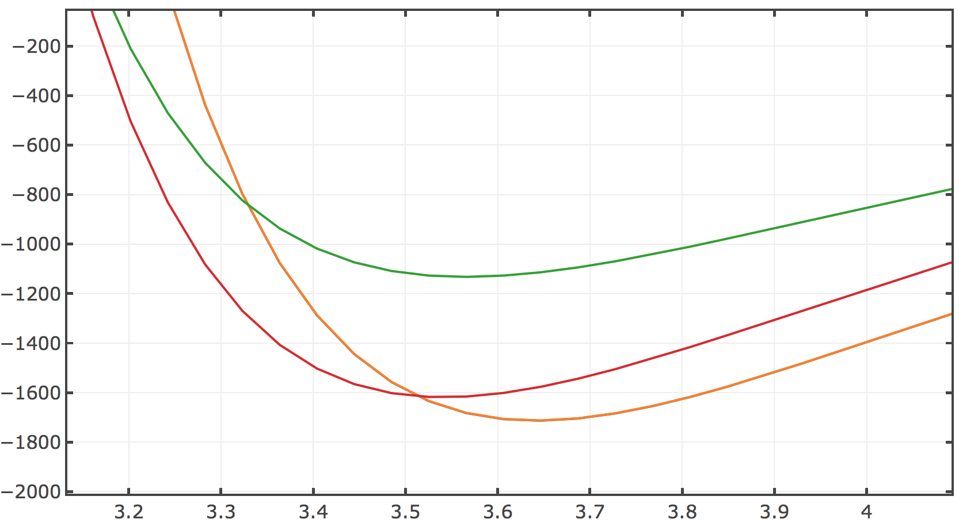
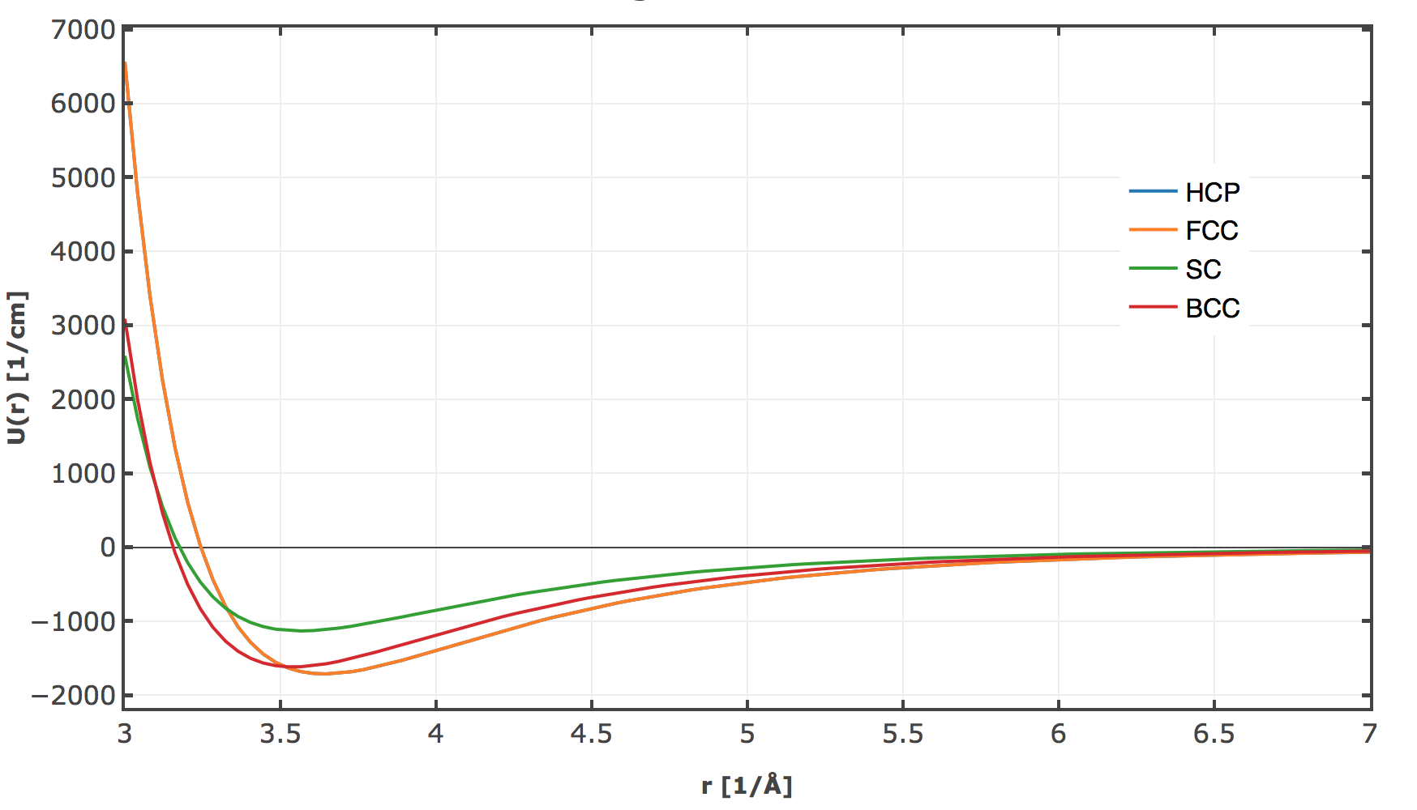
L-J Model

Slide 4

FCC or HCP?
 | Spacing Å | Energy cm⁻¹
SC | 3.56 | -1132.4812
BCC | 3.52 | -1617.4023
FCC | 3.64 | -1712.5192
HCP | 3.64 | -1713.2478
0.00042

Slide 5
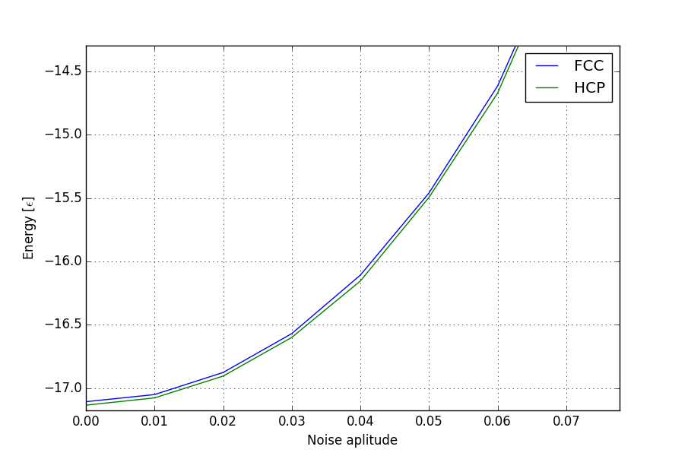
Adding Noice to the lattice

Slide 6
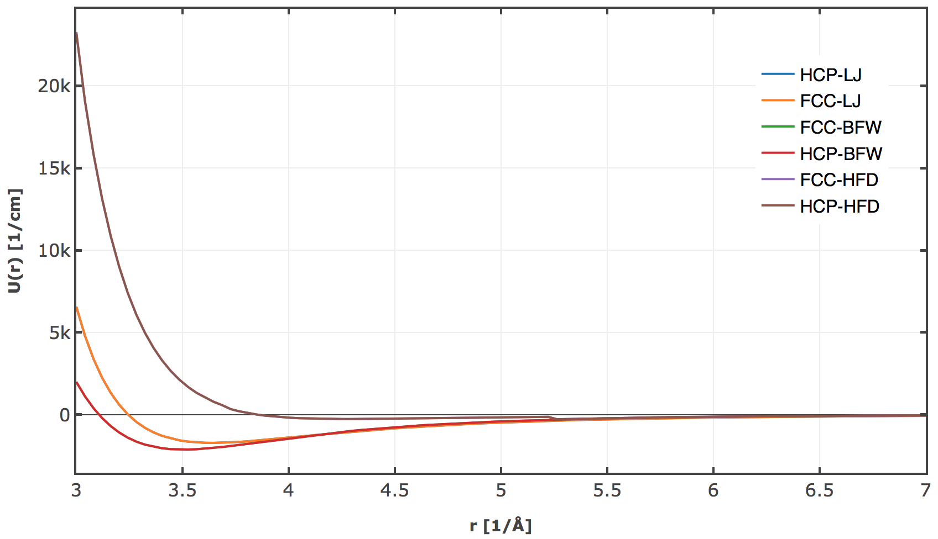

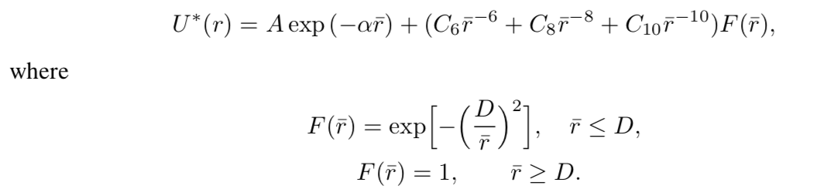
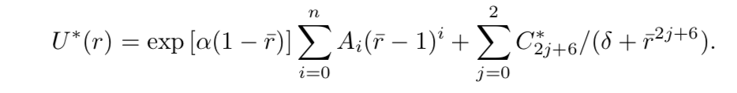
Using different potentials
HFD
BFW
0.00025

Slide 7
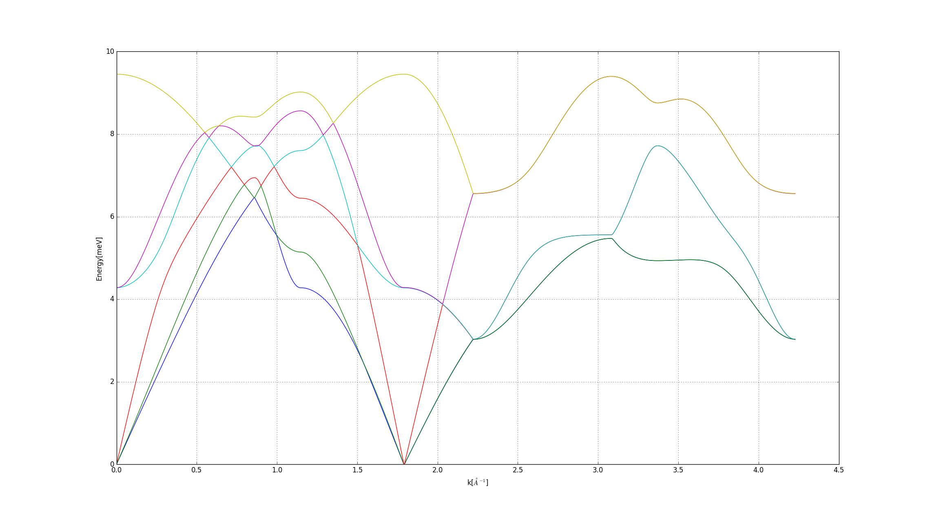
Phonon Dispersion
Γ
K
m
Γ
A
l
H
A

Slide 8
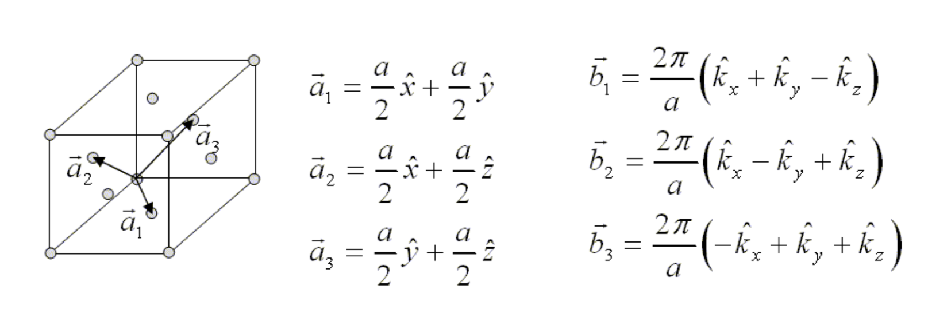
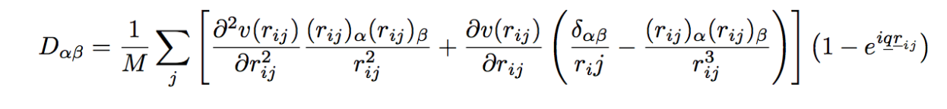
Phonon Dispersion
FCC

Slide 9
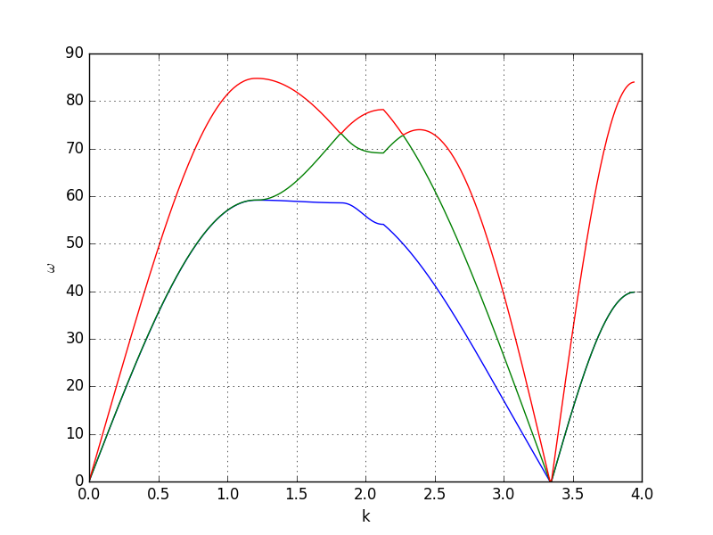
Phonon Dispersion
𝚪
X
W
K
𝚪
L

Slide 10
Phonon Dispersion
𝚪
X
W
K
𝚪
L
2943m/s
1786m/s
1350m/s

Slide 11
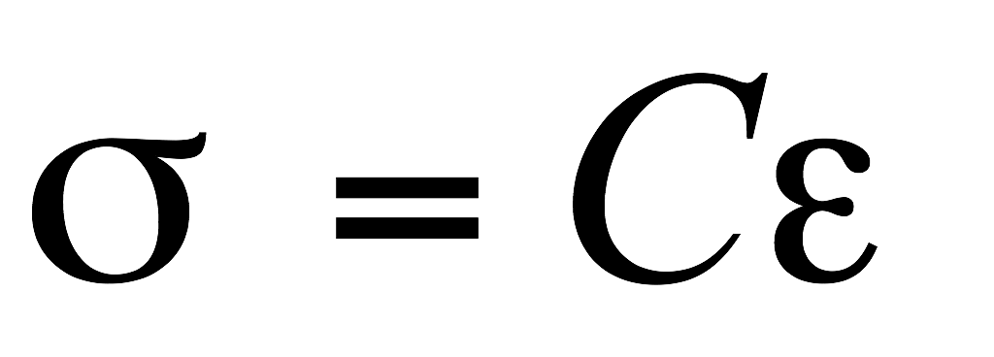
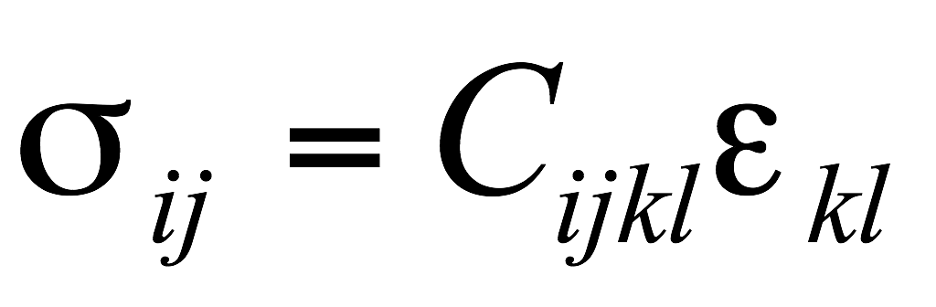
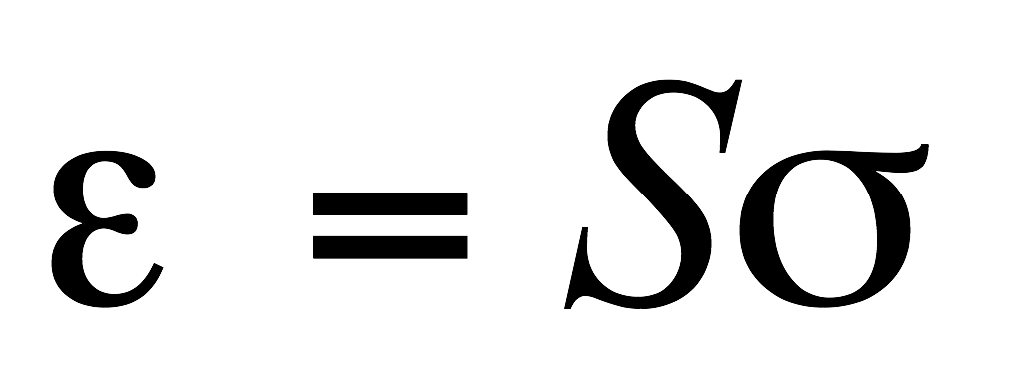
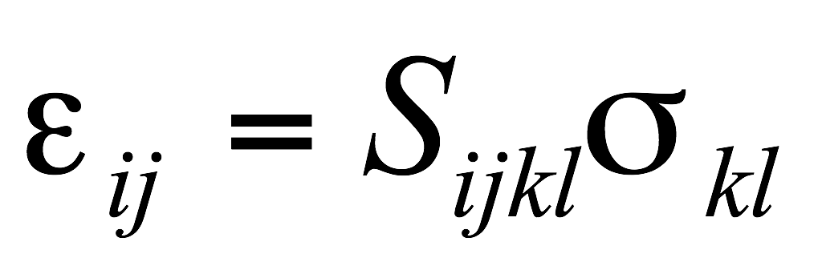
Sound Velocity
For small stress, strain is proportional (linearly varies with) strain ➢ Hooke’s law.
The proportionality constants are 4th order (rank) tensors.
Tensor form
Hooke’s law

Slide 12
Elastic Constants
The total number of expected components are: 2D: 2×2×2×2 = 16 3D: 3×3×3×3 = 81.
But, not all of these are independent.
➢ Cijkl = Cijlk (also, Sijkl = Sijlk) ➢ Cijkl = Cjikl (also, Sijkl = Sjikl) ⇒ only 36 of the 81 components are independent (for even the most general crystal)*.
From energy arguments it can further be seen that: Cijkl = Cklij (also, Sijkl = Sklij)* ⇒ of the 36 components only 21 survive (even for the crystal of the lowest symmetry).
All cubic crystals (irrespective of their point group symmetry) have only 3 independent components ⇒ Cijkl (or Sijkl)→ these are C1111, C1122, C2323.
This is further reduced in the case of isotropic materials to 2 independent constants (C1111, C1122). Usually, these independent constants are written as E & ν.
Hence, for second rank tensor properties (like magnetic susceptibility, χij) cubic crystals are isotropic, but, not for forth rank tensor properties like Elastic Stiffness.

Slide 13
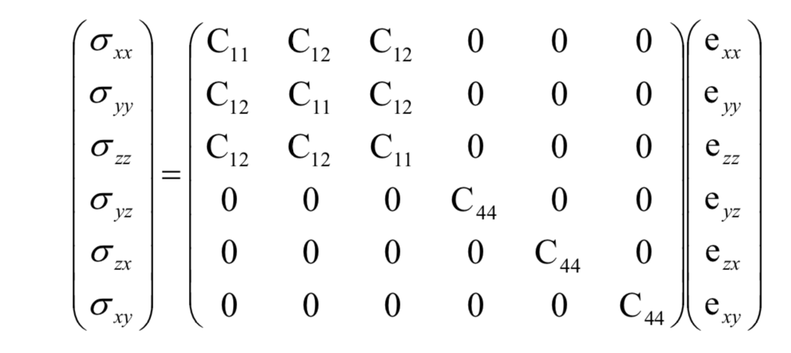
Elastic Constants

Slide 14
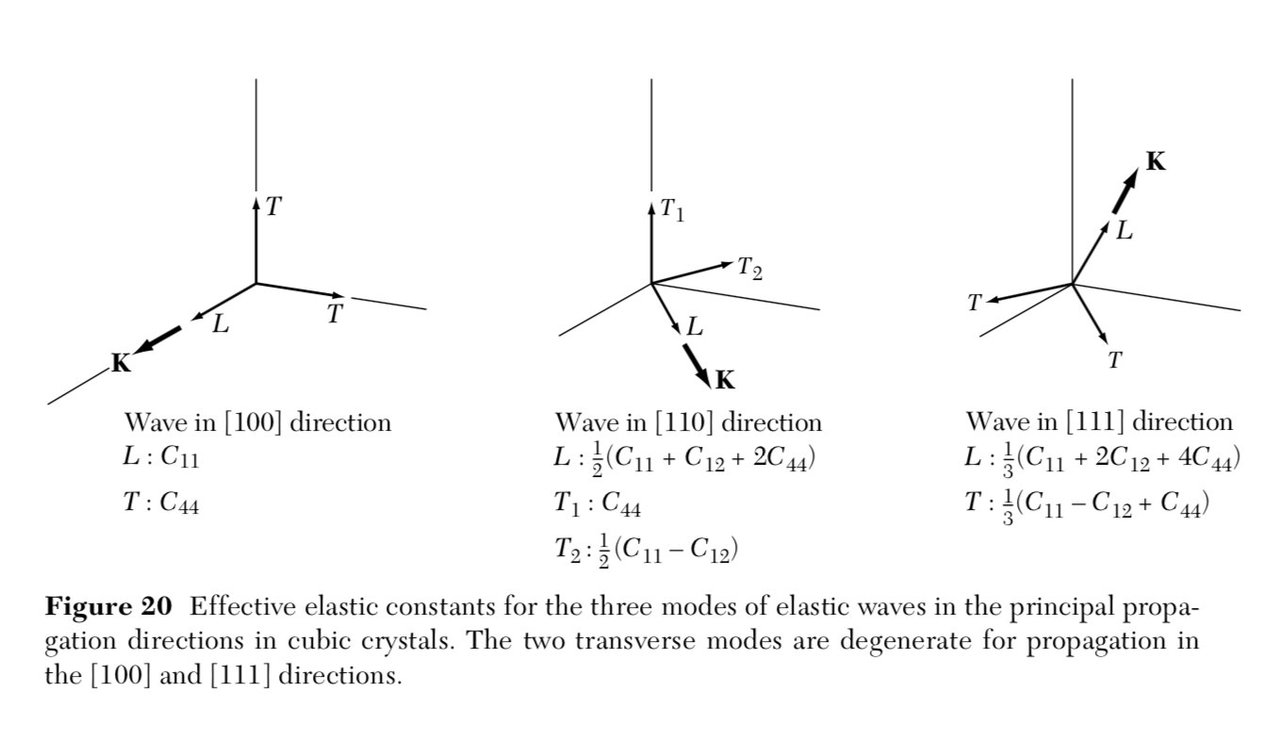
Velocities
velocity ⍵/k of a longitudinal wave in the [100] direction is vs = (C11/⍴)^{1/2}
velocity ⍵/k of a transverse wave in the [100] direction is vs = (C44/⍴)^{1/2}
velocity ⍵/k of a longitudinal wave in the [110] vs = ((C11+C12+2C44)/⍴)^{1/2}

Slide 15
Velocities
velocity ⍵/k of a longitudinal wave in the [100] direction is vs1 = (C11/⍴)^{1/2}
velocity ⍵/k of a transverse wave in the [100] direction is vs2 = (C44/⍴)^{1/2}
velocity ⍵/k of a longitudinal wave in the [110] vs3 = ((C11+C12+2C44)/⍴)^{1/2}
Sound Speed Elastic Constants Litterature values
Vs1 = 1786m/s
C11 = 3.2GPa
C11 = 2.3GPa
Vs2 = 1350m/s
C44 = 1.8GPa
C44 = 1.5GPa
Vs3 = 2081m/s
C12 = 1.8GPa
C12 = 1.2GPa

Slide 16
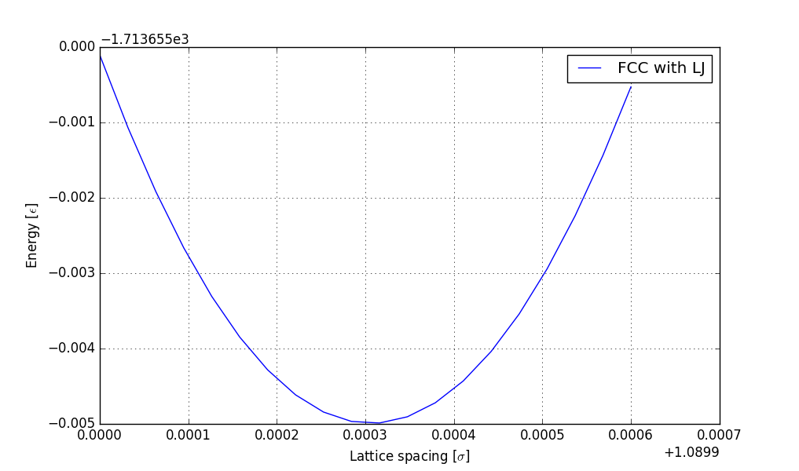
Elastic Constants From Strain

Slide 17
Velocities
From three different deformations we could get the three constants
Stress/strain Cij Sound Speed Cij Litterature values
C11 = 2.6GPa
C11 = 3.2GPa
C11 = 2.3GPa
C11 = 3.2GPa
C44 = 1.5GPa
C44 = 1.8GPa
C44 = 1.5GPa
C44 = 1.8GPa
C12 = 1.1GPa
C12 = 1.8GPa
C12 = 1.2GPa
C12 = 1.8GPa

